Slide 1


ECEN 403
LANL Neuromorphic Chip:
Adam O’Brien
Cason Love
Dr. Michael Saccone (Sponsor)
Pranav Dhulipala (TA)

Slide 2
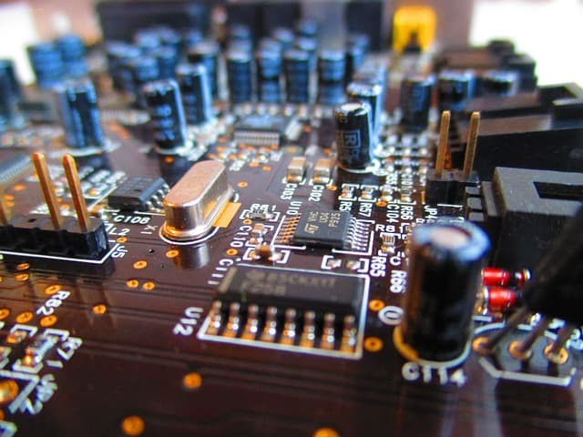
Executive summary
Problem statement:
Limits of conventional computing
Need smaller scale Neuromorphic Chip
Our Neuromorphic Chip will:
Recognize activation phrase from user
Rid the need of analog-to-digital conversion
Less transistors

Slide 3
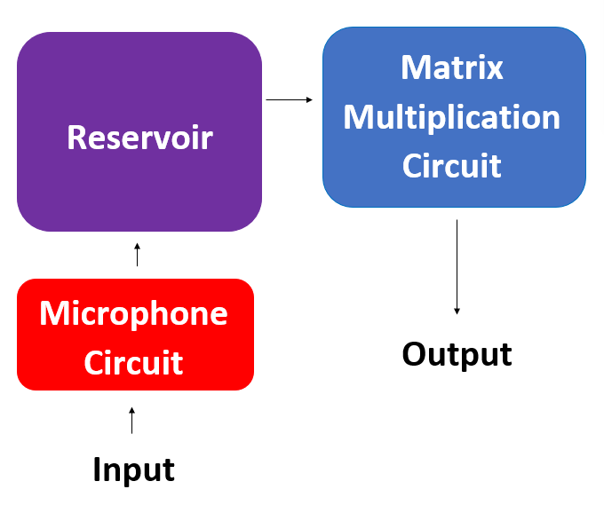
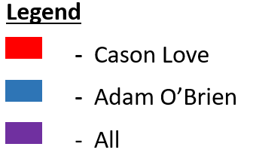
System Overview
Notes:
Cloud server and database

Slide 4
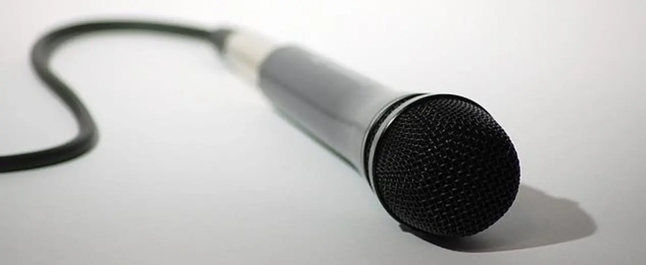
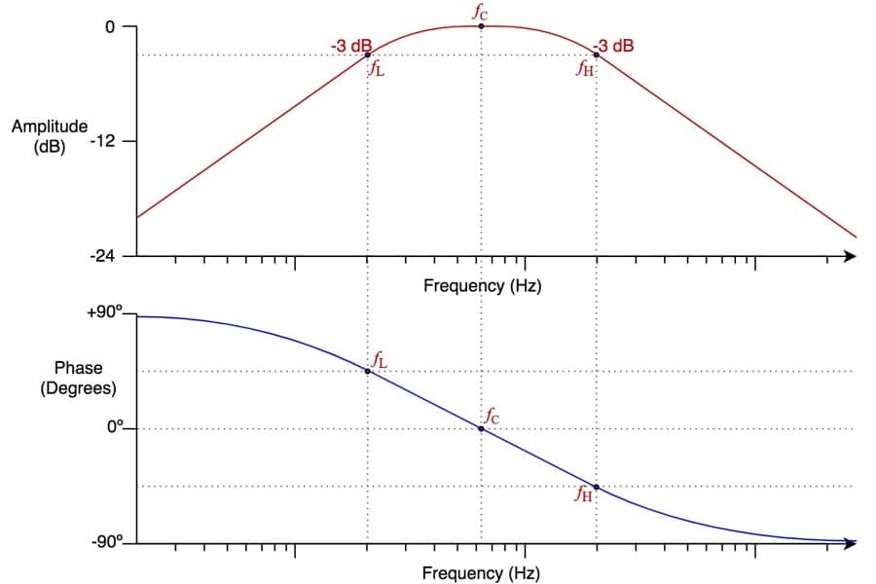
Microphone Subsystem (Cason)
Gathers input from the user to input to the reservoir and amplifies it to the needed voltage from the reservoir
Filters the frequencies to match the human voice range of 80 Hz - 260 Hz

Slide 5
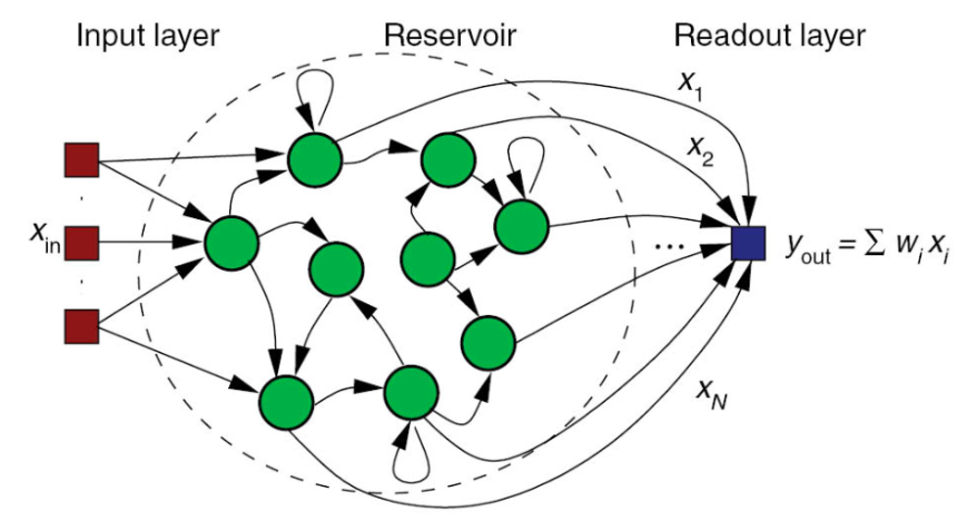
Reservoir Subsystem (Cason and Adam)
Reservoir Computing
Processer or “Brain” of System
Output fed to Matrix Multiplication Circuit

Slide 6
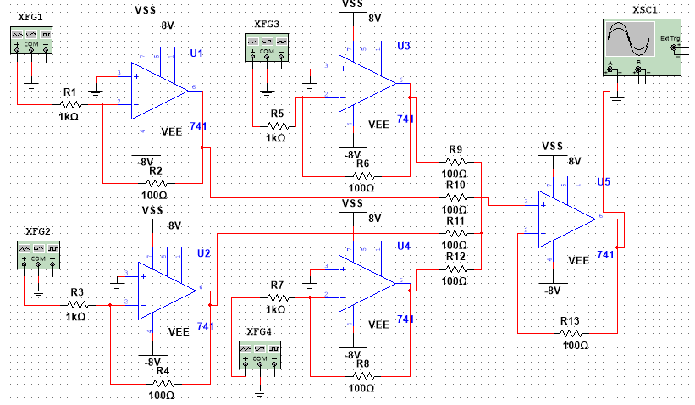
Matrix Multiplication Subsystem (Adam)
Completed
Designed and simulated circuit
Tested circuit on breadboard
To Do
Obtain output matrix
Retest on breadboard, then perfboard

Slide 7
Execution Plan
 | March 7th | March 28th | April 4th | April 11th
Microphone Circuit | Amplification Circuit Built on Breadboard | Microphone and Filter Output Validated on Breadboard | Perfboard Built | Microphone Output Validated on Perfboard
Reservoir | Single Neuron and Amplifier Circuits Built | All Neurons and Amplifier Circuits Built on Perfboard | All Neurons and Amplifier Circuits Tested on Perfboard | Reservoir Validated on Perfboard
Matrix Multiplication Circuit | Inverting Amplifiers Built and Verified | System Built on Breadboard | System Built on Perfboard | Final Testing and Validation Completed

Slide 8
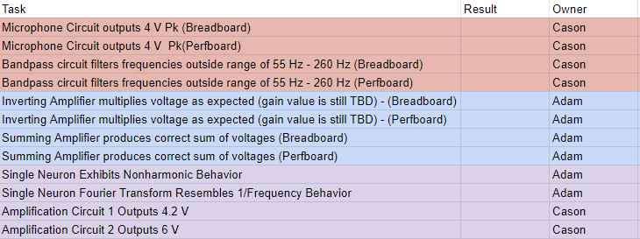
Validation Plan

Slide 9
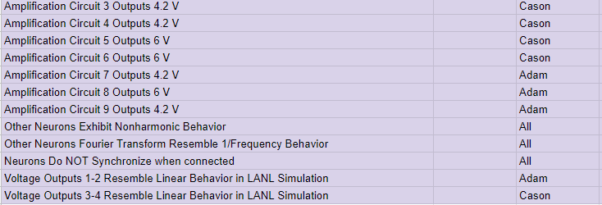
Validation Plan (cont.)

Slide 10
Bibliography
https://www.howtogeek.com/26898/the-how-to-geek-guide-to-computer-microphones/
https://mynewmicrophone.com/audio-eq-what-is-a-band-pass-filter-how-do-bpfs-work/
https://www.wyzant.com/resources/lessons/math/precalculus/matrices/matrix_multiplication/
https://www.analogictips.com/general-tips-preventing-problems-analog-circuits/

